Slide 1

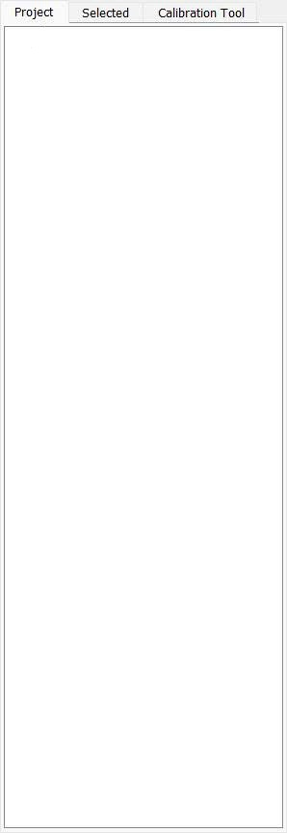

Camera Configuration
X
Camera:
V
Camera Thread
Connect
Disconnect
Apply and Close
Cancel
Hardware Configuration
X
Port:
V
Baud:
V
Status Query Period:
ms
Apply and Close
Cancel

Slide 2

Motor ControlPanel
X
Motor ControlPanel
X
Height:
V
mm
Height:
V
mm
Speed:
V
rpm
Speed:
V
rpm
Close
Refill
Close

Slide 3



Height:
V
mm
Speed:
V
rpm
Camera & Video
Camera Previewer

Slide 4


Height:
V
mm
Speed:
V
rpm
Camera & Video
Camera Previewer

Slide 5


Height:
V
mm
Speed:
V
rpm
Camera & Video
Camera Previewer

Slide 6
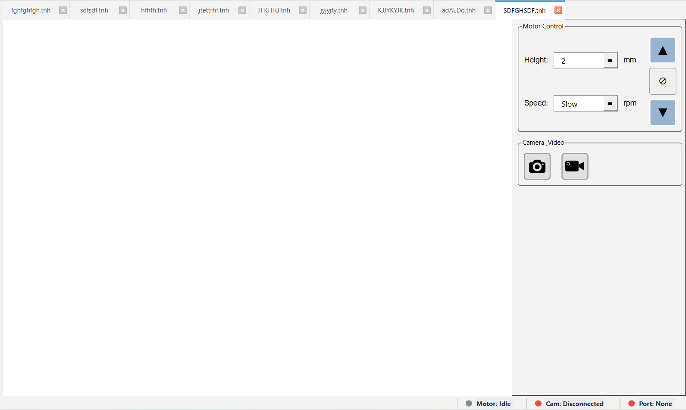

Slide 7
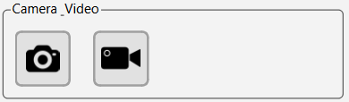




Slide 8


Slide 9


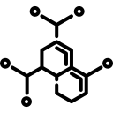



TNH OPTIMA
Version 1.1

Slide 10
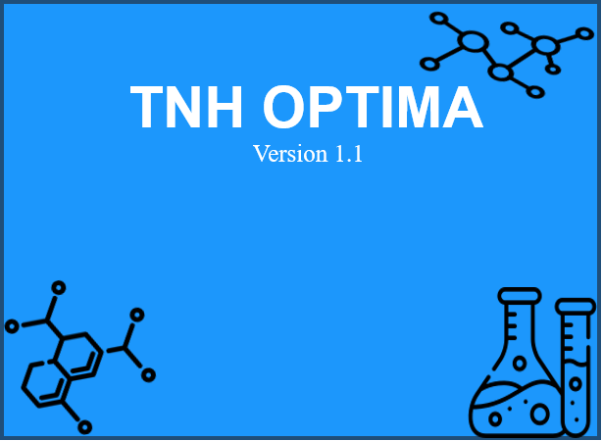

Slide 11
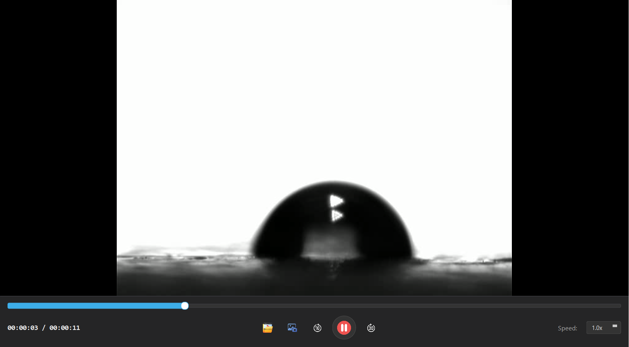
T= 15 s

